Slide 1
INDUSTRIAL TRAINING
ON
“Node JS &
CRUD Operation”
Presented By~~ Saurabh Raj Singh (15stuhh0109)

Slide 2
Technologies used in the project
Node js
Express JS
Mongo DB
Rest API
Postman

Slide 3
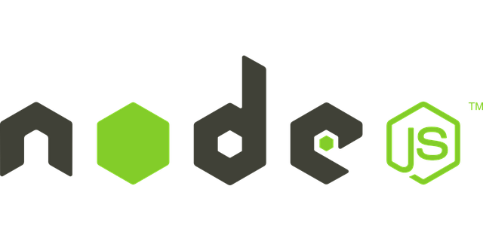
NODE JS
Node.js is a platform built on Chrome's JavaScript runtime for easily building fast, scalable network applications.
Node.js uses an event-driven, non-blocking I/O model that makes it lightweight and efficient,
perfect for data-intensive real-time applications that run across distributed devices.

Slide 4

Express JS
Express is a minimal and flexible node.js web application framework, providing a robust set of features for building single and multi-page, and hybrid web applications.

Slide 5



What is Express ?
Node JS based web framework
Based on connect middleware
Makes usage of Node JS even easier
Easy to implement REST API
Supports several template rendering engines (Jade, EJS)
o Supports partials -> so you can split your HTML in fragments
Asynchronous
Implements MVC pattern

Slide 6



Express – What is it?
Allows to set up middlewares to respond to HTTP Requests.
Defines a routing table which is used to perform different action based on HTTP Method and URL.
Allows to dynamically render HTML Pages based on passing arguments to templates.

Slide 7
MongoDB | RDBMS
Collection | Table
Document | Row
Index | Index
Embedded Document | Join
Reference | Foreign Key

Slide 8

Example
>db.mycol.insert({ _id: ObjectId(7df78ad8902c), title: 'MongoDB Overview', description: 'MongoDB is no sql database', by: 'tutorials point', url: 'http://www.tutorialspoint. com', tags: ['mongodb',
'database', 'NoSQL'], likes: 100 })

Slide 9



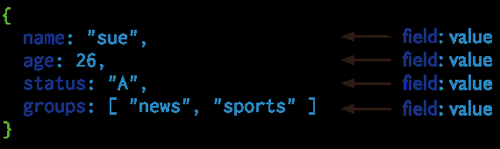
MongoDB - Document

Slide 10

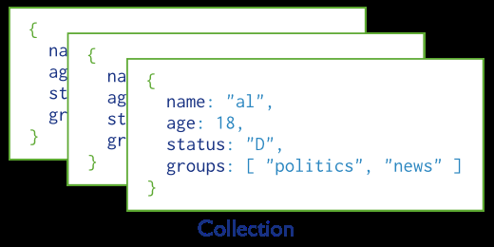
MongoDB - Collection

Slide 11
Rest API
REST stands for REpresentational State Transfer. REST is web standards based architecture and uses HTTP Protocol. It revolves around resource where every component is a resource and a resource is accessed by a common interface using HTTP standard methods. REST was first introduced by Roy Fielding in 2000.

Slide 12
Files which are included in our Project
Package.json files:
- Package.json store the nodeJs project configuration including dependencies
-Package.json is a plain JSON(Java Script Object Notation) text file which contains all metadata information about Node JS Project or application.
-Every Node JS Package or Module should have this file at root directory to describe its metadata in plain JSON Object format.

Slide 13
Index.js
So the index.js is most likely the entry point for requiring a module.
Api-routes
all api endpoint shall be defined in this file

Slide 14
Controller
processes HTTP requests and defines available endpoints
Model
manages database layer (request and response)

Slide 15
HTTP methods
Following four HTTP methods are commonly used in my project.
GET − This is used to provide a read only access to a resource.
PUT − This is used to create a new resource.
DELETE − This is used to remove a resource.
POST − This is used to update a existing resource or create a new resource.

Slide 16
Postman is a very good tool for test and debugging API endpoint. It looks like…

Slide 17
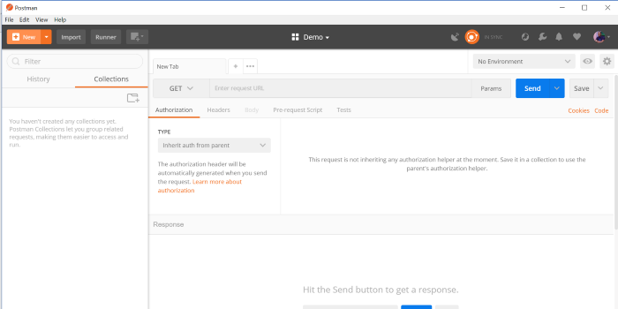

Slide 18
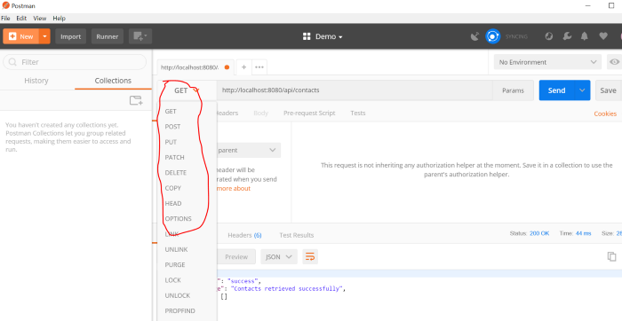
It also supports a long list of request types including basic HTTP GET, POST, PUT, DELETE.

Slide 19
So finally we have tested CRUD operations for following files
Student:Name,Email,Gender,Enrollno,
Phone.
Comment:text,Comment_By,postID
Post:Type,Body,created_date.
Course:Coursename,fee.

Slide 20
THANK YOU !!

